Slide 1

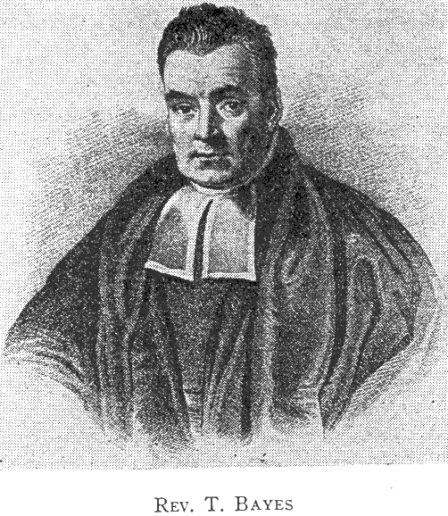
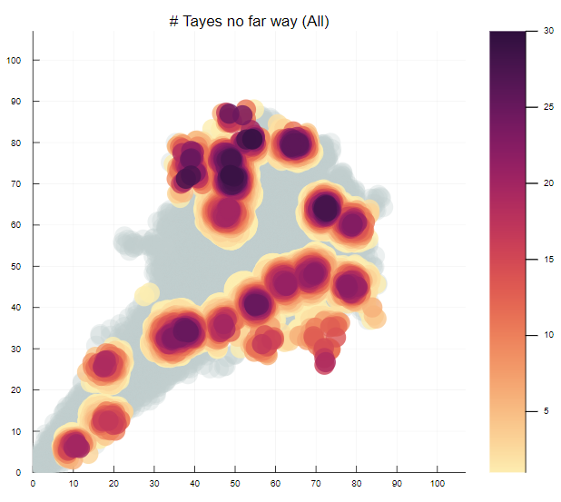


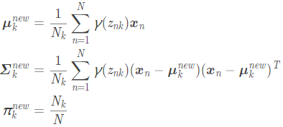
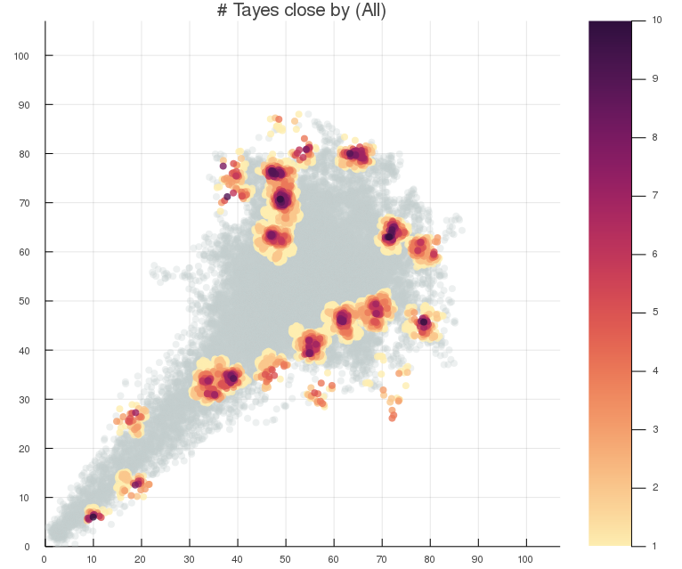
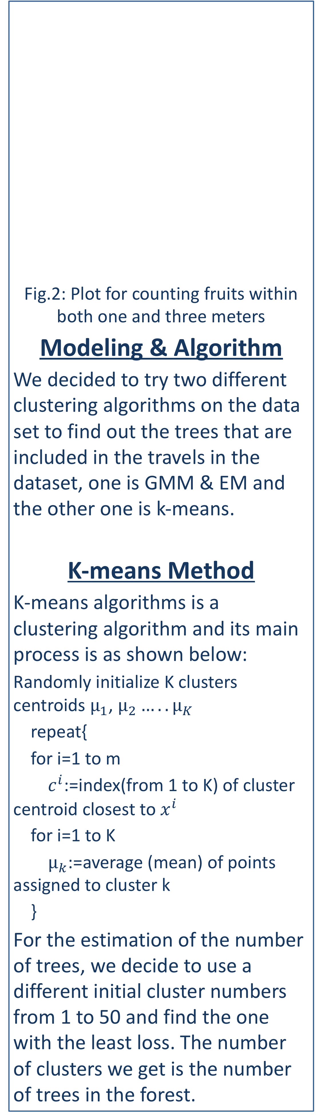
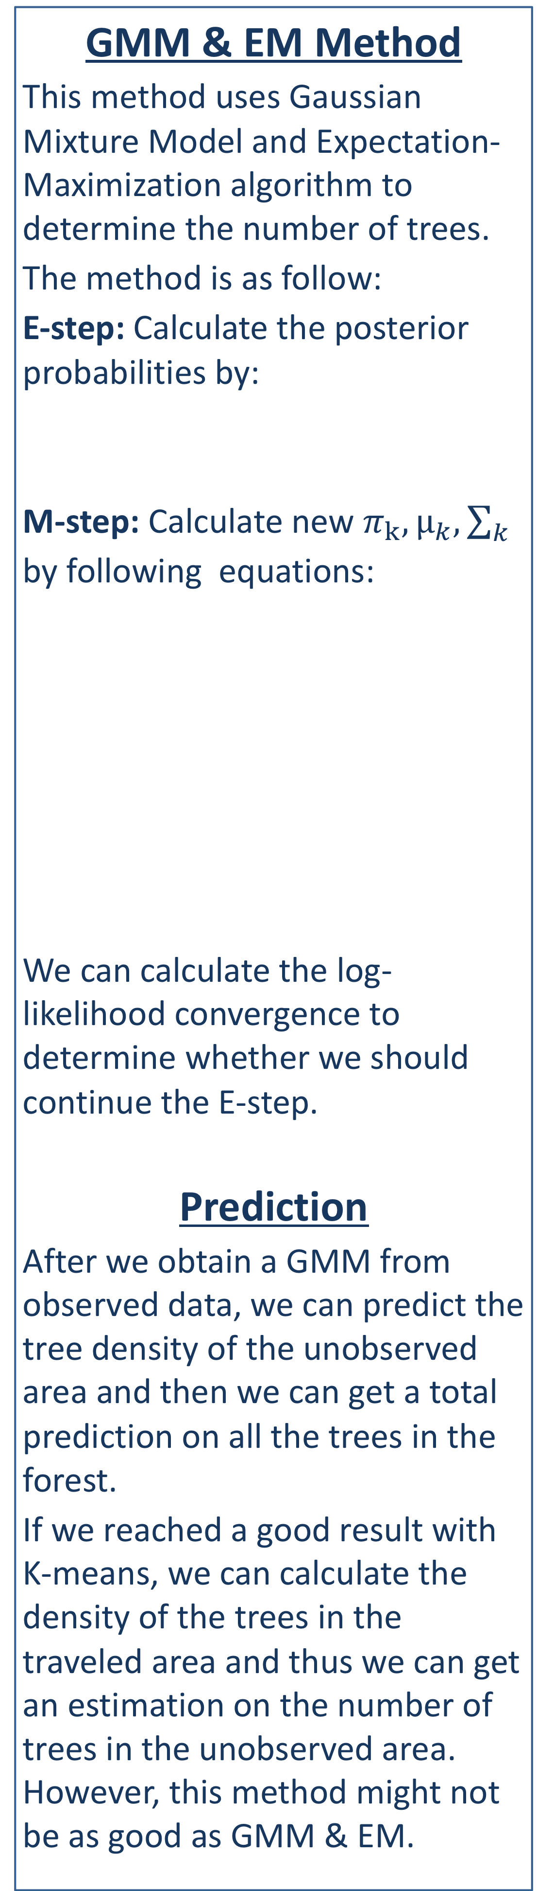
VE414 • Bayesian Analysis Project
Abstract:
In this project, we have a set of track data in a forest and try to use the data to predict the position of trees. The input data includes 24094 data points and we are going to apply the Bayesian model to predict the position and number of Jiuling, which is the hidden trees in the forest.
Team Members: Peiyan Xia, Bingcheng Hu, Xuanyi Zhao
Instructor: Jing Liu
Problem Statement
We are required to find the location of hidden trees in a given forest of 107*107 area. The information we currently have is the number of the fruits of the invisible trees, which is recorded by a spell. The spell records along the position of several different trips and records the number of fruits within one meter and three meters.
Data visualization
We used Julia to preprocess the data and visualize it, so that we can get a better view of our current data. For the visualization process, we plotted two different graphs. One is plotted using only fruit numbers observed within one meter and the other one is plotted using the observation result within both one and three meters. Here are the two plots:
Fig.1: Plot for only counting fruits within one meter
Since it is confirmed that there is no extra fruit that we can observe, we think the data is valid and we can process the data we currently have.
Fig.2: Plot for counting fruits within both one and three meters
Modeling & Algorithm
We decided to try two different clustering algorithms on the data set to find out the trees that are included in the travels in the dataset, one is GMM & EM and the other one is k-means.
K-means Method
K-means algorithms is a clustering algorithm and its main process is as shown below:
Randomly initialize K clusters centroids $μ_{1}$, $μ_{2}…..μ_{K}$
repeat{
for i=1 to m
$c^{i}$:=index(from 1 to K) of cluster centroid closest to $x^{i}$
for i=1 to K
$μ_{k}$:=average (mean) of points assigned to cluster k
}
For the estimation of the number of trees, we decide to use a different initial cluster numbers from 1 to 50 and find the one with the least loss. The number of clusters we get is the number of trees in the forest.
GMM & EM Method
This method uses Gaussian Mixture Model and Expectation-Maximization algorithm to determine the number of trees.
The method is as follow:
E-step: Calculate the posterior probabilities by:
M-step: Calculate new $π_{k},μ_{k},\sum_{k}{ }$
by following equations:
We can calculate the log-likelihood convergence to determine whether we should continue the E-step.
Prediction
After we obtain a GMM from observed data, we can predict the tree density of the unobserved area and then we can get a total prediction on all the trees in the forest.
If we reached a good result with K-means, we can calculate the density of the trees in the traveled area and thus we can get an estimation on the number of trees in the unobserved area. However, this method might not be as good as GMM & EM.

